Slide 1
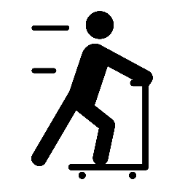
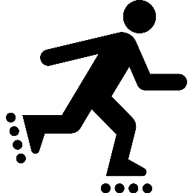
Youth Pedestrian Safety Lessons
DAY 1 – THE BASICS OF WALKING

Slide 2
Video: Walking Basics (2 min.): https://bit.ly/2VzkCCw

Slide 3
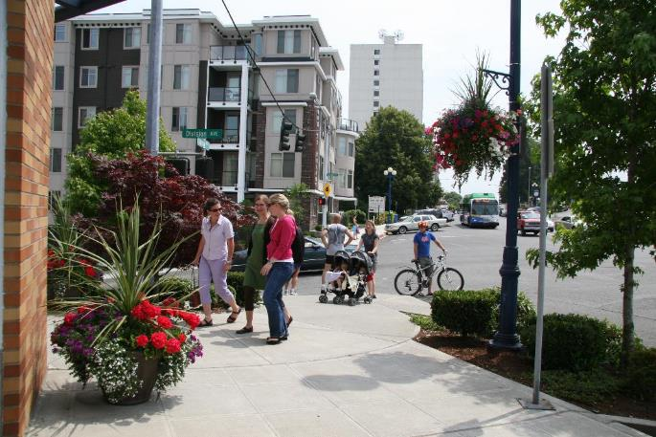
PEDESTRIAN: Someone who walks or moves about using a wheelchair.
ACTION: Walk in place.

Slide 4
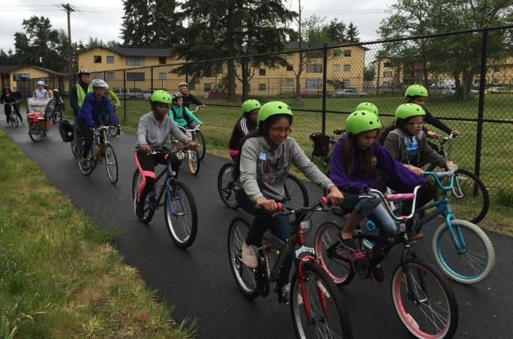
BICYCLIST: Someone who rides a bicycle.
ACTION: Lay on your back and do bicycle crunches OR move your body like you're riding a bike.

Slide 5
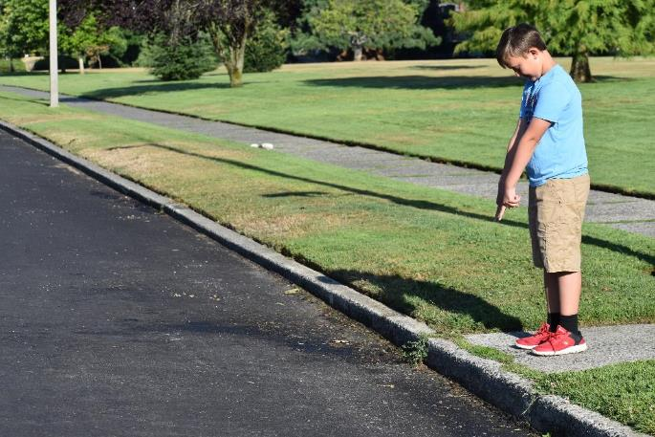
EDGE: A border or outside limit to an area. In this case, where the sidewalk meets the road.
ACTION: Raise your hands above your head, then bring them down and point at an imaginary line in front of you. Repeat.

Slide 6
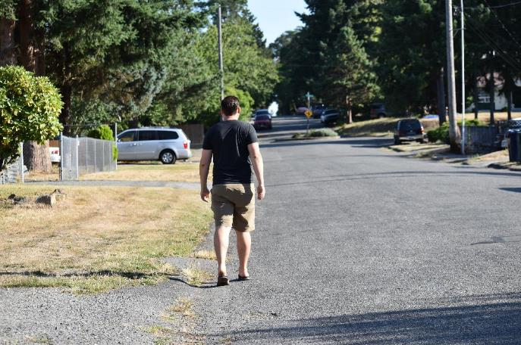
SHOULDER: The edge of the road where cars do not drive. Sometimes a white line separates the shoulder from the road. Cars also sometimes park in the shoulder. The shoulder is used as a sidewalk if there is no sidewalk.
ACTION: Twist your body while brushing each shoulder with the opposite hand.

Slide 7
Day 1, Activity 3: Going on a Walk

Slide 8
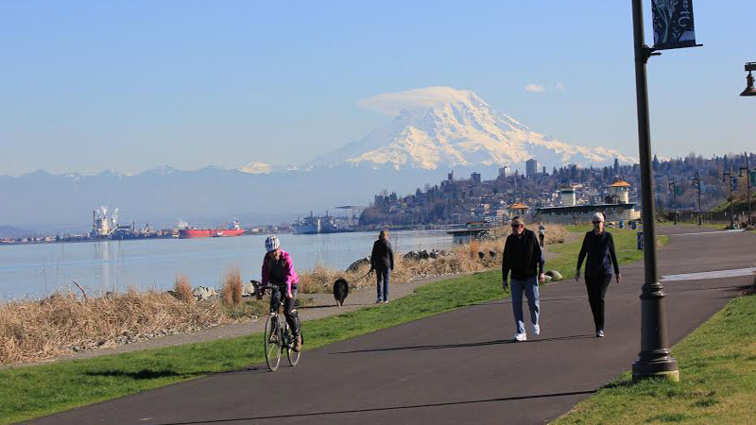
We're in Tacoma!
Start jogging!

Slide 9
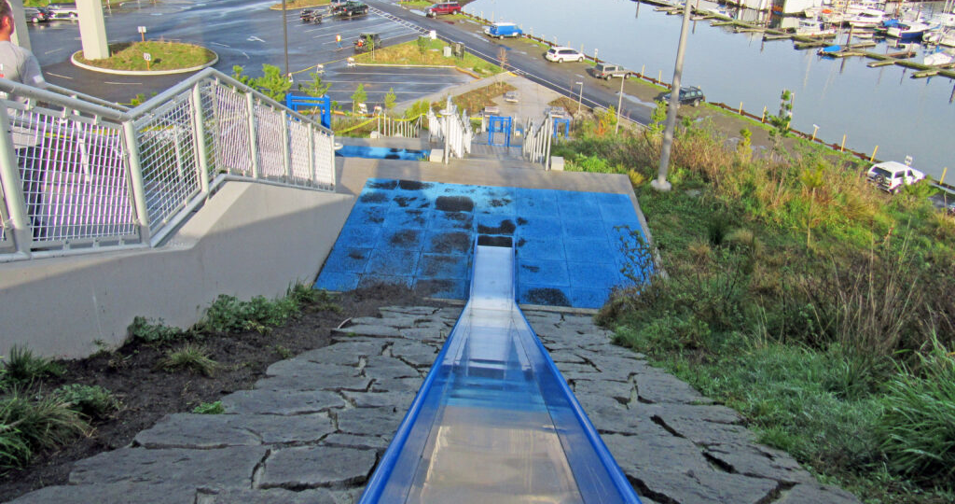
We need to go down the slides! Crouch down, put your hands up, and say, "Weeee!"

Slide 10
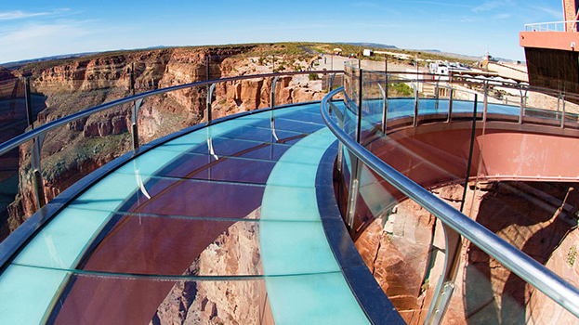
We're on the glass bridge over the Grand Canyon!
Walk on your tippy-toes and don't look down!

Slide 11
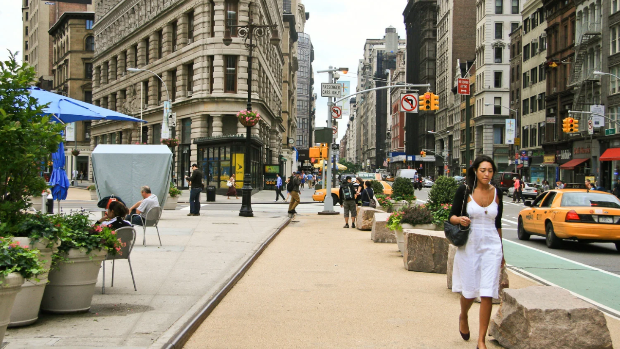
We're in New York!
Start jogging but make sure to dodge the people!

Slide 12
We're in Florida!
Run to the beach and go for a swim!

Slide 13
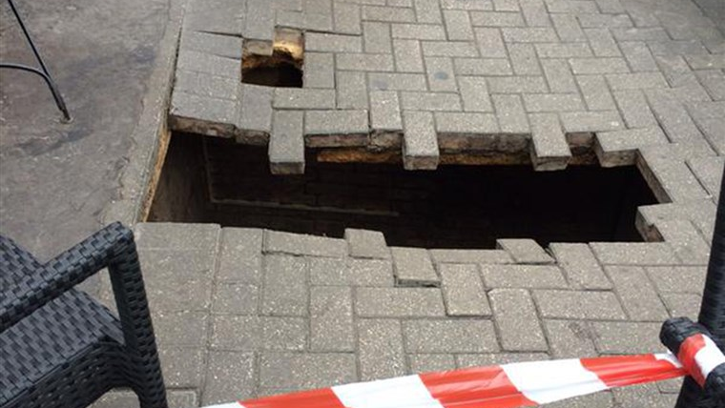
Watch out! Jump in place 10 times to get over the hole!

Slide 14
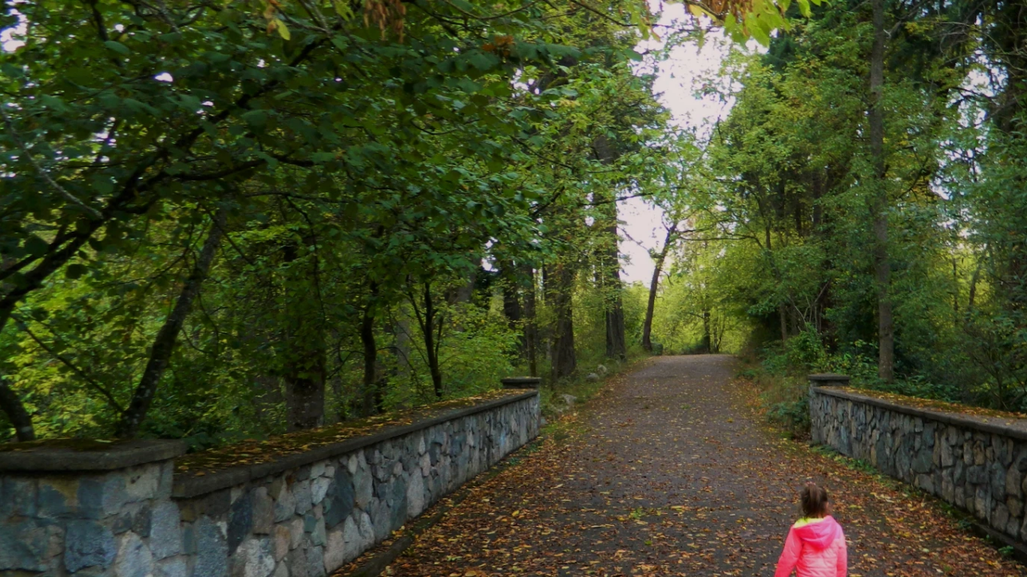
We're back in Tacoma at Wapato Park! Let's start our walk back home.

